Slide 1



GRADE 11 · ALGEBRA II · WEEK 7
Pre-Session
Home task before class
Lesson 6-5
Properties of Logarithms
Watch · Study · Check · Submit on the LMS before class
Lesson 6-6
Exponential and Logarithmic Equations
Mr Malek Thiab
FAITH, RIGHTEOUSNESS AND WISDOM
Notes:
Speaker notes: Send this pre-session to students before Week 7. It covers Lesson 6-5 Properties of Logarithms and Lesson 6-6 Exponential and Logarithmic Equations. Students work through six stations at home: watch a short video, study two worked examples, and answer three readiness questions, for each lesson. Their answers tell you where to start the in-class Diagnose.

Slide 2


Your home journey
Six stations before the lesson: watch, study the examples, check yourself, twice.
Examples
Lesson 6-5
Watch
Lesson 6-6
Check
Lesson 6-6
2
4
6
1
3
5
Watch
Lesson 6-5
Check
Lesson 6-5
Examples
Lesson 6-6
FAITH, RIGHTEOUSNESS AND WISDOM
Notes:
Speaker notes: Walk through the map with students: stations 1 to 3 prepare Lesson 6-5, stations 4 to 6 prepare Lesson 6-6. Each lesson: Watch (about 5 to 8 minutes), Examples, Check. In slideshow mode the Morph transition zooms the circles into the breadcrumb at the top of each later slide.

Slide 3

1
2
3
4
5
6
STATION 1 · WATCH · LESSON 6-5
Properties of Logarithms
WATCH BEFORE CLASS · 5:40
KEY IDEA
Properties of Logarithms
The Organic Chemistry Tutor · 5:40
Open on YouTube
LISTEN FOR
What happens to a logarithm when the number inside is a product, and when it is a quotient.
What happens to an exponent that sits on the number inside a logarithm.
How the change of base formula writes one logarithm as a ratio of two logarithms.
HSA.SSE.A.2 · HSF.BF.A.2 · HSF.LE.A.4 · HSA.CED.A.1 · HSA.REI.A.1
FAITH, RIGHTEOUSNESS AND WISDOM
Mr Malek Thiab · 3
Notes:
Speaker notes (Lesson 6-5, Station 1, Watch and key idea):
Video: Properties of Logarithms by The Organic Chemistry Tutor, length 5:40, https://www.youtube.com/watch?v=Jtv9Lnf7Zw8
Listen-for answers: product inside becomes a sum of logs, quotient becomes a difference, an exponent inside comes out front as a multiplier, and change of base gives log x over log b with any consistent base. Verbal misconception: log(M + N) is NOT log M + log N; only a product or quotient splits. Adaptive routing: if most students cannot say the quotient rule in words, open Diagnose by deriving it from 2^5 / 2^2 = 2^3.

Slide 4
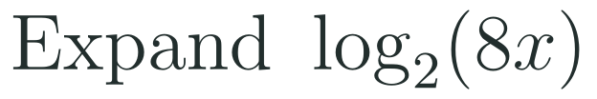


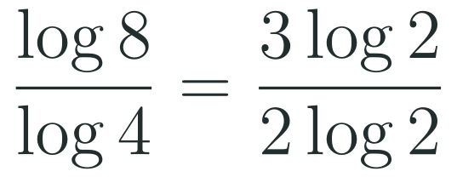

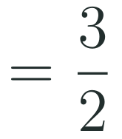
1
2
3
4
5
6
STATION 2 · EXAMPLES · LESSON 6-5
Study the worked examples
EXAMPLE A
1
EXAMPLE B
2
HSA.SSE.A.2 · HSF.BF.A.2 · HSF.LE.A.4 · HSA.CED.A.1 · HSA.REI.A.1
FAITH, RIGHTEOUSNESS AND WISDOM
Mr Malek Thiab · 4
Notes:
Speaker notes (Lesson 6-5, Station 2, Worked examples):
Example 1: log_2(8x) = log_2 8 + log_2 x = 3 + log_2 x because 2^3 = 8. Example 2: log_4 8 = log 8 / log 4 = 3 log 2 / (2 log 2) = 3/2; check 4^(3/2) = 8. Misconceptions: writing log 8 - log 4 instead of a ratio; rounding before cancelling; putting the base on top of the ratio. Adaptive routing: if students are unsure about writing 8 as 2^3 and 4 as 2^2, spend 2 minutes on powers of 2 first.

Slide 5
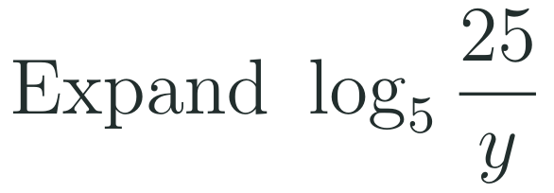


1
2
3
4
5
6
STATION 3 · CHECK · LESSON 6-5
Check yourself: three questions
1
2
3
Done when
you can name the rule you used for each question and write each answer without a calculator.
HSA.SSE.A.2 · HSF.BF.A.2 · HSF.LE.A.4 · HSA.CED.A.1 · HSA.REI.A.1
FAITH, RIGHTEOUSNESS AND WISDOM
Mr Malek Thiab · 5
Notes:
Speaker notes (Lesson 6-5, Station 3, Readiness check):
Q1: log_5(25/y) = log_5 25 - log_5 y = 2 - log_5 y. Q2: 2 log_3 x = log_3 x^2, then log_3 x^2 + log_3 5 = log_3(5x^2). Q3: log_8 32 = log 32 / log 8 = 5 log 2 / 3 log 2 = 5/3; check 8^(5/3) = 2^5 = 32. Misconceptions: Q1 writing log_5 25 + log_5 y or 25 - y; Q2 writing log_3(2x + 5) or log_3(10x); Q3 answering 4 by dividing 32 by 8. Adaptive routing: if most students miss Q2, spend the first 3 minutes of Diagnose on moving a coefficient up as a power, then combining. If most miss Q3, start with writing both numbers as powers of 2.

Slide 6

1
2
3
4
5
6
STATION 4 · WATCH · LESSON 6-6
Exponential and Logarithmic Equations
WATCH BEFORE CLASS · 7:08
KEY IDEA
Solving Exponential and Logarithmic Equations
Professor Dave Explains · 7:08
Open on YouTube
LISTEN FOR
When both sides of an exponential equation can be written with the same base, and what you do next.
What you do when the bases cannot match, and where the variable goes.
Why a solution to a logarithmic equation must be checked in the original equation.
HSA.SSE.A.2 · HSF.BF.A.2 · HSF.LE.A.4 · HSA.CED.A.1 · HSA.REI.A.1
FAITH, RIGHTEOUSNESS AND WISDOM
Mr Malek Thiab · 6
Notes:
Speaker notes (Lesson 6-6, Station 4, Watch and key idea):
Video: Solving Exponential and Logarithmic Equations by Professor Dave Explains, length 7:08, https://www.youtube.com/watch?v=10I_TVuYLkQ
Listen-for answers: write both sides with one base and equate the exponents; otherwise take a logarithm of both sides and use the power rule so the variable comes down; logarithmic solutions can make the inside of a log zero or negative, so they must be checked. Verbal misconception: dividing 32 by 4 to get x. Scope note: this preview covers equations only. Adaptive routing: if most students cannot say why the check is needed, begin Diagnose with log_2(-4) and ask what power of 2 gives -4.

Slide 7

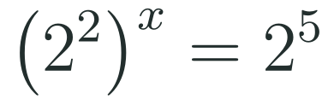
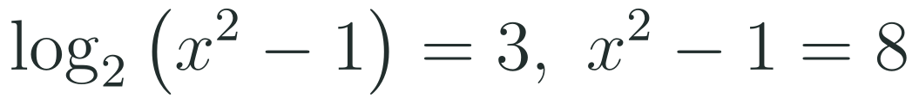


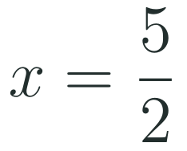
1
2
3
4
5
6
STATION 5 · EXAMPLES · LESSON 6-6
Study the worked examples
EXAMPLE A
1
EXAMPLE B
2
HSA.SSE.A.2 · HSF.BF.A.2 · HSF.LE.A.4 · HSA.CED.A.1 · HSA.REI.A.1
FAITH, RIGHTEOUSNESS AND WISDOM
Mr Malek Thiab · 7
Notes:
Speaker notes (Lesson 6-6, Station 5, Worked examples):
Example 1: 4^x = 32, so (2^2)^x = 2^5, 2x = 5, x = 5/2; check 4^(5/2) = 2^5 = 32. Example 2: product rule gives log_2(x^2 - 1) = 3, so x^2 - 1 = 2^3 = 8, x^2 = 9, x = 3 or -3. At x = -3 the terms are log_2(-2) and log_2(-4), undefined, so reject it. At x = 3: log_2 4 + log_2 2 = 2 + 1 = 3, correct. Misconceptions: forgetting the check; writing 2^(2x) as 4^2 x; applying log of a sum as a sum of logs on the left. Adaptive routing: if students are unsure of 4 = 2^2, spend 2 minutes on matching bases.

Slide 8

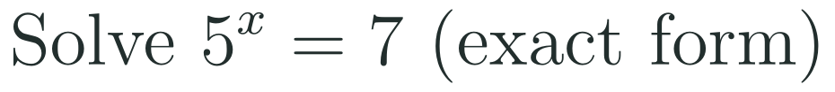
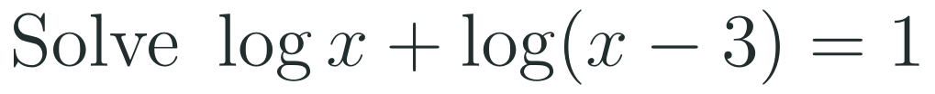
1
2
3
4
5
6
STATION 6 · CHECK · LESSON 6-6
Check yourself: three questions
1
2
3
Done when
you have checked every logarithmic answer in the original equation and written each exact answer in simplest form.
HSA.SSE.A.2 · HSF.BF.A.2 · HSF.LE.A.4 · HSA.CED.A.1 · HSA.REI.A.1
FAITH, RIGHTEOUSNESS AND WISDOM
Mr Malek Thiab · 8
Notes:
Speaker notes (Lesson 6-6, Station 6, Readiness check):
Q1: 27^x = 9, so 3^(3x) = 3^2, 3x = 2, x = 2/3; check 27^(2/3) = 9. Q2: take log of both sides: x log 5 = log 7, so x = log 7 / log 5 (about 1.209; the calculator is not needed for the exact form). Q3: log x + log(x - 3) = 1 gives log(x(x - 3)) = 1, so x^2 - 3x = 10, x^2 - 3x - 10 = 0, (x - 5)(x + 2) = 0, x = 5 or -2. x = -2 makes log(-2) undefined, so x = 5; check log 5 + log 2 = log 10 = 1. Misconceptions: Q1 answering 3 or 1/3; Q2 writing x = 7/5 or log 7 - log 5; Q3 keeping both roots. Adaptive routing: if most students miss Q3, spend the first 3 minutes of Diagnose on the check step using x = -2. If most miss Q2, rehearse where the exponent goes after taking the log.

Slide 9
Ready for class
Bring your answers and your questions.
Examples 6-5
Watch 6-6
Check 6-6
✓
✓
✓
✓
✓
✓
Watch 6-5
Check 6-5
Examples 6-6
Last week you met logarithms as inverses of exponentials, and you can already switch between exponential form and logarithmic form.
FAITH, RIGHTEOUSNESS AND WISDOM
Notes:
Speaker notes: Collect the submitted answers from the LMS before class and sort questions by how many students missed them. Start the in-class Diagnose on the least secure check question. Last week you met logarithms as inverses of exponentials, and you can already switch between exponential form and logarithmic form.

